Slide 1



Talent Framework
Employee Journey

Slide 2
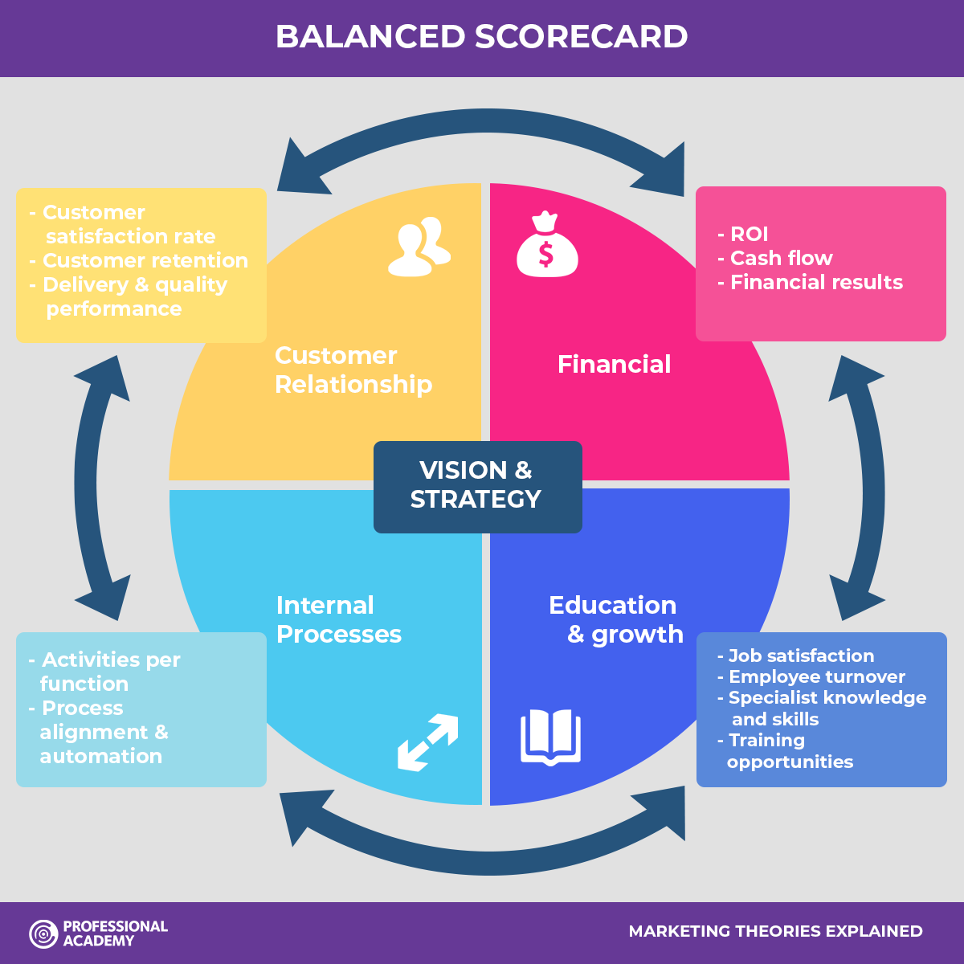
Business Balanced Score Card:

Slide 3









Employee Journey:
Attraction
Selection
Onboarding
Cont. PM
L&D
Managers Capabilities
Career Development
Engagement
Succession / Hi-Potential

Slide 4



1- Attraction:
Ideal Work Experience / Skills
Where to be found?
Why to choose your Organization?
Candidate Persona

Slide 5


Attraction:
Why to choose your Company?
Comp & Ben
Career
Culture & Environment
EVP

Slide 6




Attraction:
EVP Promotion?
Social media/Ads
Career sites
Inbound Recruitment
Events/Current staff

Slide 7



2- Selection:
Structured - CBI
Assessment Center
Candidate Experience

Slide 8




3- Onboarding:
Preboarding
Orientation
Assimilation DM Role
90 Days Survey

Slide 9



4- Continuous Performance Management:
Agile Goals
Check in – Snapshot Review
Accumulate rating

Slide 10



5- L&D
Internal Academy
Integrated Learning Solutions
Learning Tracks

Slide 11



6- Managers capabilities:
Leadership Profile
Measurement 360 ?
Ongoing Development

Slide 12



7- Career Development:
Formal CD Framework
Framework Communication
Methods & Practices

Slide 13




8- Succession Mgmt.
& Hi-Potential:
Identify
Assess
Develop
Retention

Slide 14

9- Engagement:
Candidate Experience
90 Days Survey
Manager Capability – Appraisal System
Development Opportunities

Slide 15

Thank You

